Slide 1
BMS project report
NCS Pte. Ltd.
10 Sep 2014 Prepared by Lu Peng

Slide 2
Project background
Internet fast development and populace.
More complex physical works can be replace by technology.
Library manage system is so, it to replace human operation.

Slide 3
Project design
Main functions

Slide 4
details

Slide 5
Main page design
User module: Login.cshtml, Register.cshtml;
Reader manage module:Index.cshtml, Created.cshtml, Edit.cshtml, Delete.cshtml;
Book manage module: module:Index.cshtml, Created.cshtml, Edit.cshtml , Delete.cshtml;
borrowItem manage module:Index.cshtml, Created.cshtml, Return.cshtml , Cancel.cshtml;

Slide 6
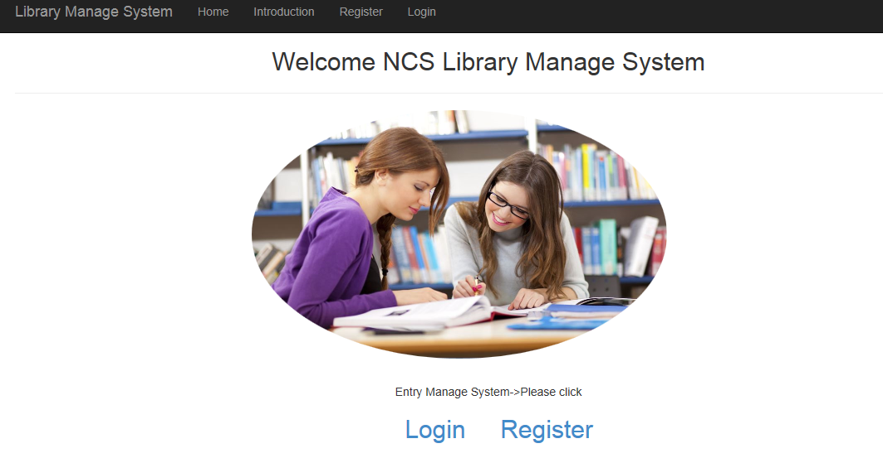
Main pages display
Home page

Slide 7
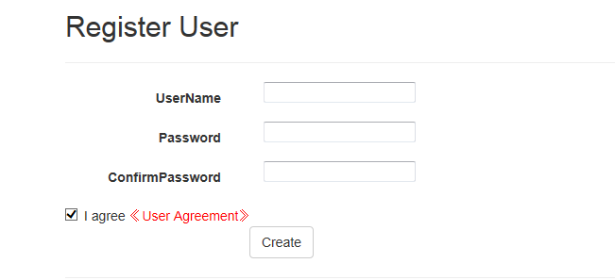
Main pages display
User register

Slide 8
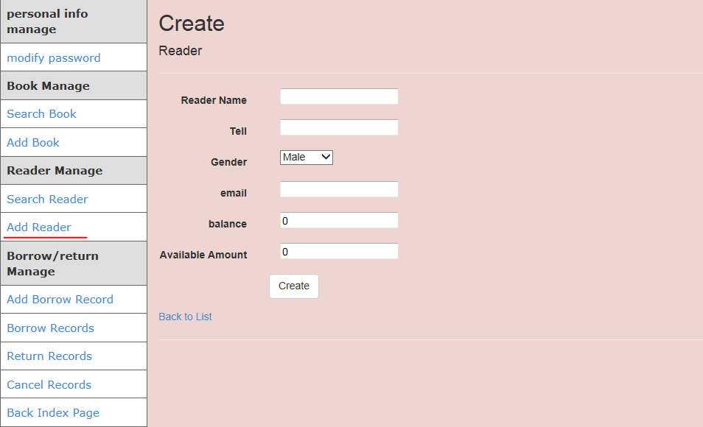
Main page design
Create reader

Slide 9
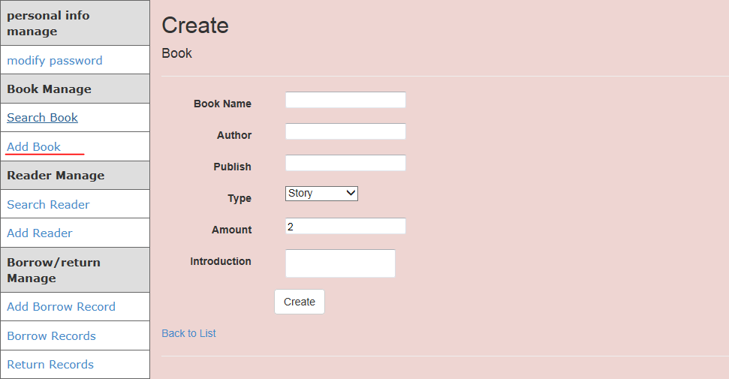
Main page design
Add book

Slide 10
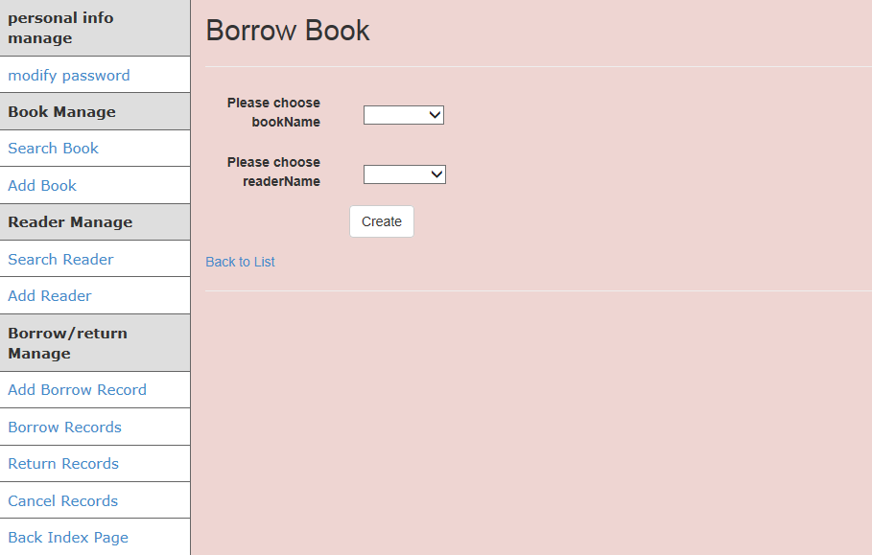
Main page design
Borrow book

Slide 11
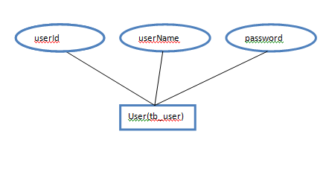
Models design(Entity class)
User

Slide 12
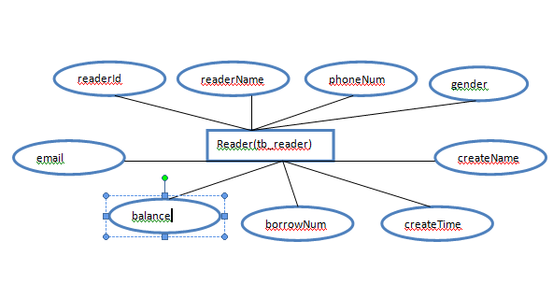
Models design(Entity class)
Reader

Slide 13
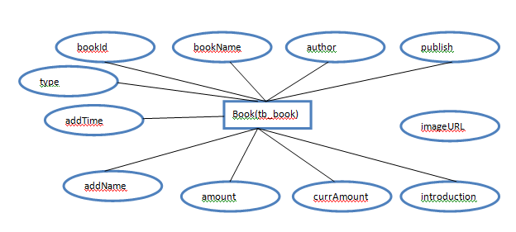
Models design(Entity class)
Book

Slide 14
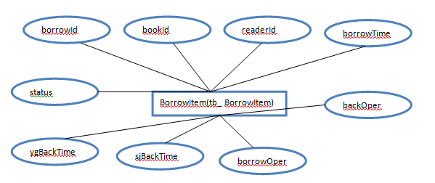
Models design(Entity class)
BorrowItem

Slide 15
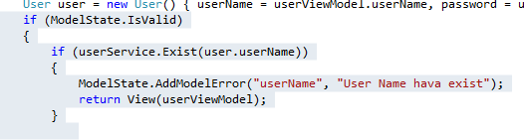

Experience sharing
how to deal with problem about “ModelState.AddModelError()”method abnormal display ？

Slide 16

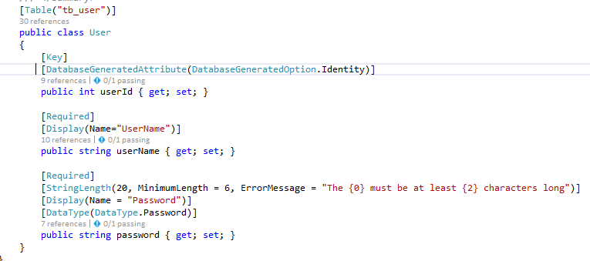
Experience sharing
Entity framework6.0 code first using
Firstly, install entityFramework reference
Create db entity cs files.

Slide 17
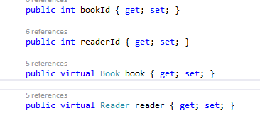
Experience sharing
Foreign key setting

Slide 18
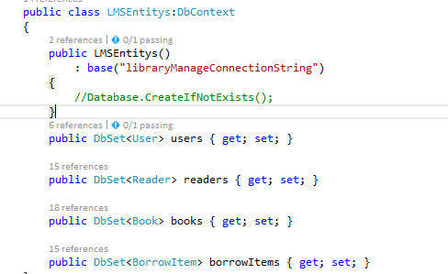
Experience sharing
LMSEntitys.cs

Slide 19
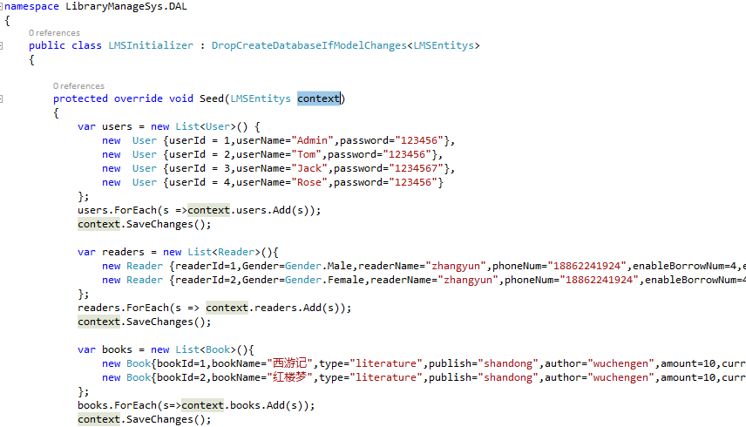

Experience sharing
LMSInitializer.cs design

Slide 20

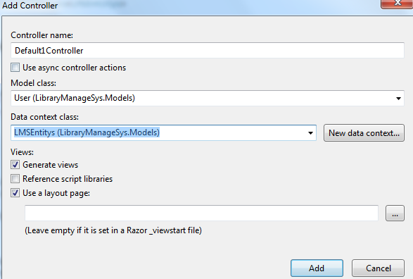
Experience sharing
Add controller and running generate tables

Slide 21

Let us be a Value Creator for your organization
Thank You

